Slide 1

Lateralization of language network in the human brain: A graph theory study
June, 2022
Yinuo Liu
Yinuo Liu, Chenghui Zhang, Haoyu Hu, Yuzheng Hu, Xiangzhen Kong

Slide 2
CONTENT
1
Introduction
2
Methods
3
Results
4
Discussion & Conclusion

Slide 3
Introduction
Part One

Slide 4
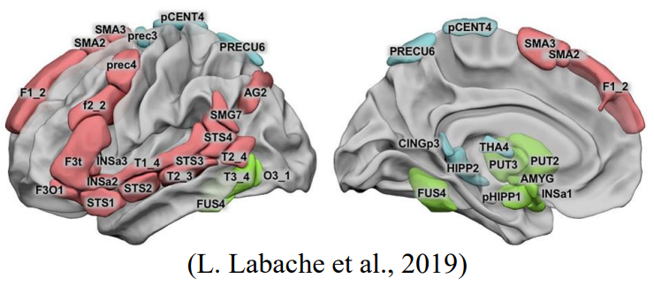
Introduction
Background and significance
Language is an important and complex function associated with multiple distributed brain regions. Typically, the left hemisphere shows greater involvement in language processing, also known as language lateralization. Previous work mainly focused on certain brain regions and investigated their individual roles in language.
Brain regions communicate and exchange information with each other. This study aims to examine how these language-related regions work together as a network. Specifically, graph theory was used to examine substantial lateralization in the topological properties and how they related to behaviors.
L. Labache et al. proposed an atlas of 32 language-related areas and divided them into three clusters.

Slide 5
Methods
Part Two

Slide 6
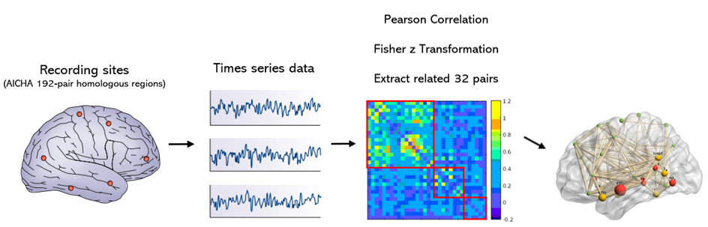
Methods
Research methods and processes
network level: calculated topographic metrics including small-world properties and network efficiency
nodal level: calculated betweenness centrality (BC), cluster coefficient (CC), degree centrality (DC), efficiency (NE), and local efficiency (NLE)
Process
Calculation
Data
Threshold
100 unrelated subjects from the Human Connectome Project were involved (54 females; age: 29±3.7 years).
In addition to the preprocessing performed by HCP, the first 10 volumes were removed, and spatial smooth, temporal detrend, nuisance regression, and band-pass filtering (0.071Hz~0.125Hz) were conducted.
To remove spurious correlations, we set the connectivity value less than 0.20 to zero. We also repeated the analyses using various sparsity thresholds from 20% to 40%, and the results were similar.

Slide 7
Results
Part Three

Slide 8
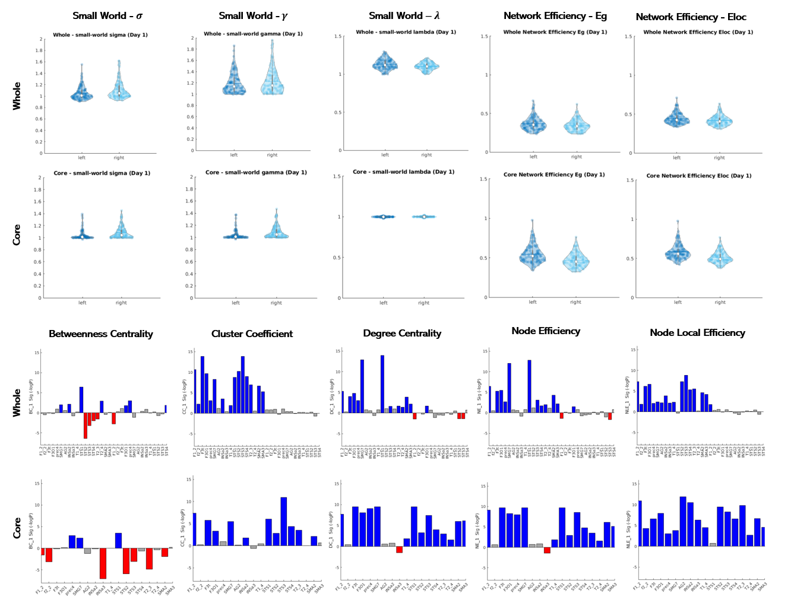
Results
Research results
Network-/Nodal-Level Differences
Correlation threshold = 0.20
Network level: The general language network of the left hemisphere showed higher network efficiency (Eloc: p=0.011) and smaller small-worldness (p=0.006) driven by larger λ (p=0.002). Similarly, left core network showed higher efficiency (Eg: p<0.001; Eloc: p<0.001) and smaller small-worldness (p<0.001) but driven by smaller γ (p<0.001).
Nodal level: For the general network, most nodes showed higher DC, CC, NE and NLE on the left. However, the numbers of dominant nodes in BC attribute on the two sides were almost equal. The core network showed similar patterns. For example, STS2 in both the general and core networks showed strong right asymmetry in BC (general: t=-5.24, p<0.001; core: t=-4.98, p<0.001).

Slide 9
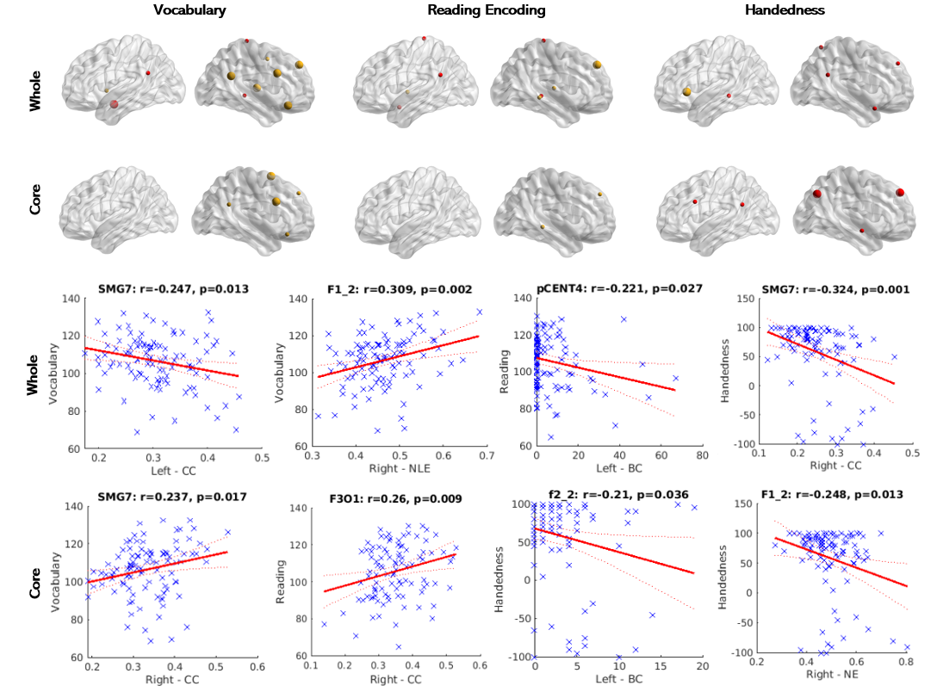
Results
Research results
Behavioral Correlations
Network level: The λ of right core network showed significantly correlation with reading decoding (r=-0.358, p<0.001), while the γ and small-worldness of left core network correlated with handedness (γ: r=-0.228, p=0.025; small-worldness: r=-0.216, p=0.031).
Nodal level: The nodal level attributes showed various correlations with behavioral measures, mainly in the right hemisphere. For example, HIPP2 (BC) of the right general network significantly correlated with reading (r=-0.373, p<0.001). F1_2 (NE) of the core network in the right hemisphere significantly correlated with handedness (r=-0.248, p=0.013) and F3O1 (CC) with reading (r=0.260, p=0.009). Further replication of the behavioral correlations is needed.

Slide 10
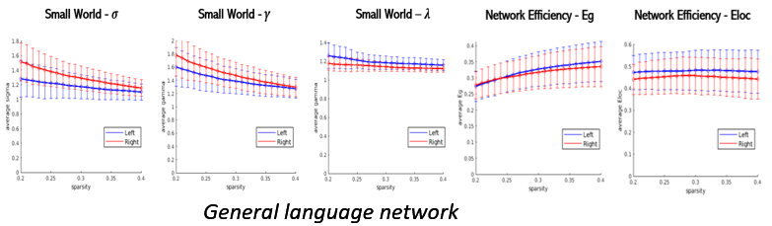
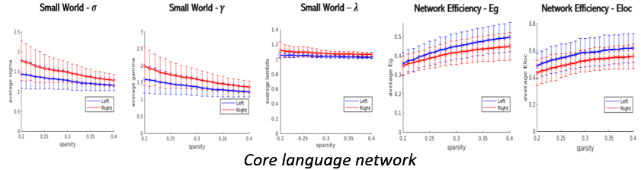
Results
Research results
General Language Network
Core Language Network
Repeated the analysis under various sparsity thresholds from 20% to 40% and results were similar.

Slide 11
Discussion & Conclusion
Part Four

Slide 12
Discussion & Conclusion
Research summary
In sum, there are significant differences in the language networks between left and right hemispheres in terms of network properties at both network level and nodal level. Language network in left hemisphere has smaller small-worldness and higher efficiency, and the left nodes are also more efficient and clustered with higher degree centrality. Interestingly, we found that more nodes in right network show significant correlations with language-related behaviors.

Slide 13
Thanks For Listening!
Yinuo Liu

